Slide 1


QGIS
A free powerful alternative to ArcMap
2017

Slide 2

QGIS
Open Source vs closed source
Open source means that the software is not proprietary, is free and anybody can use the software.
Examples of other open source projects include:
Python
Linux
Even Google assistant (Google home)
Examples of closed source projects include:
Anything developed by Microsoft (such as MS office)
ESRI products like ArcMap and Arcpy
Adobe pdf
Any software you would have to pay for
Delivering Excellence with Every Solution
2

Slide 3
QGIS
Quantum Geographical Information Systems (QGIS)
Can be used for any common GIS task that can be done in ArcMap
Reading shapefiles and rasters.
Reading csv tabular data.
Making maps.
Georeferencing images.
More complex GIS tasks
Interpolation.
Projecting data.
Geoprocessing.
Ex (Calculating the area of a shapefile)
Delivering Excellence with Every Solution
3

Slide 4
QGIS
Example
In this presentation, we will preform some simple routines a GIS analyst would often perform.
(In this case an informal survey of people’s favorite bars in Austin TX)
We will:
Create a csv file with coordinates
Add the csv to QGIS and view the data
Add a basemap, and label the points
Use the map layout tool
Add Scalebar and Legend
Export png or pdf
Delivering Excellence with Every Solution
4

Slide 5
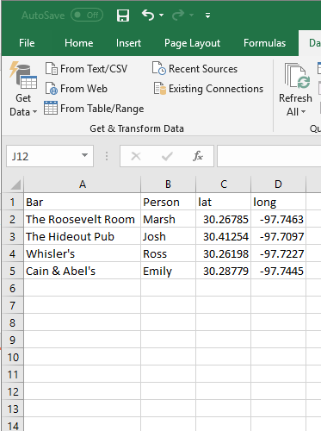
QGIS
Example
Csv with point data
Delivering Excellence with Every Solution
5

Slide 6
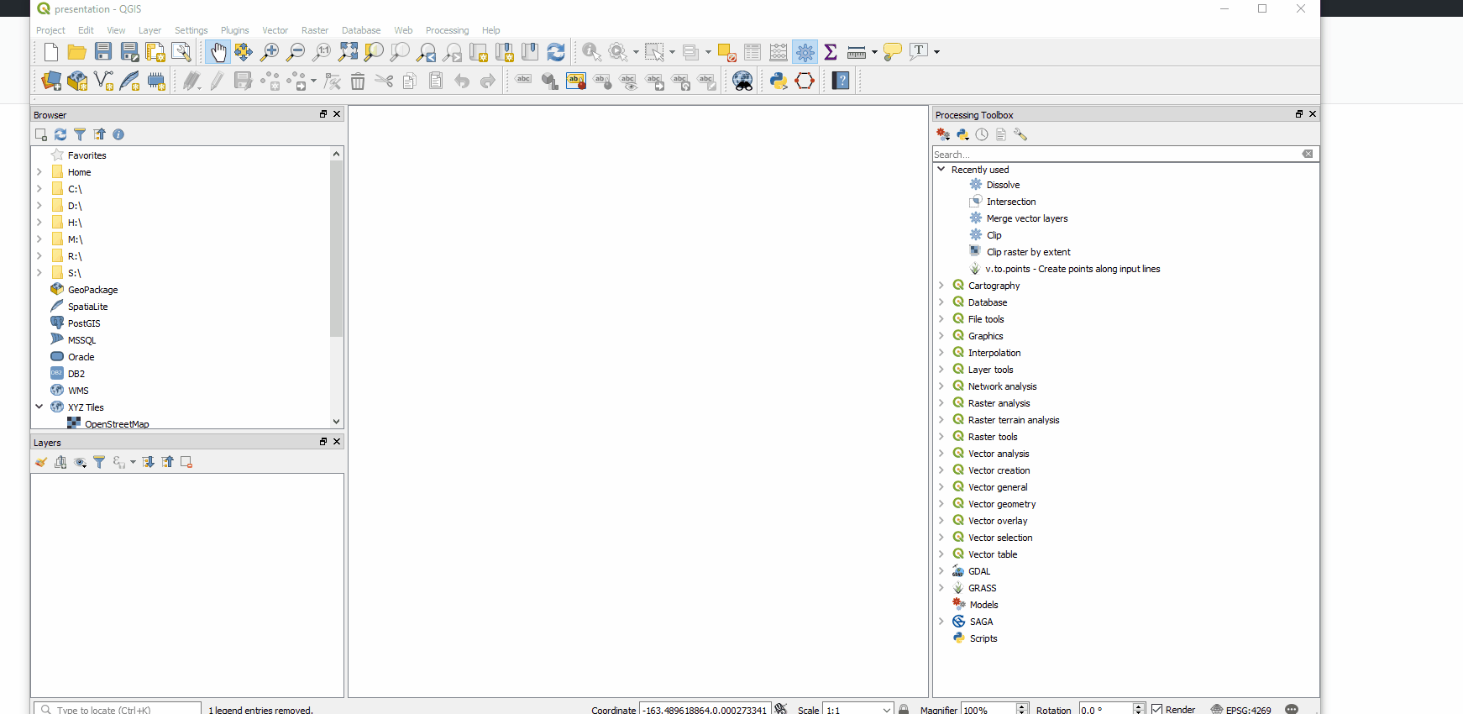
QGIS
Add csv or delaminated text files
Can be used for any common GIS task
Reading shapefiles and rasters.
Reading csv tabular data.
Making maps.
Georeferencing images.
More complex GIS tasks
Interpolation.
Projecting data.
Geoprocessing.
Ex (Calculating the area of a shapefile)
Delivering Excellence with Every Solution
6

Slide 7
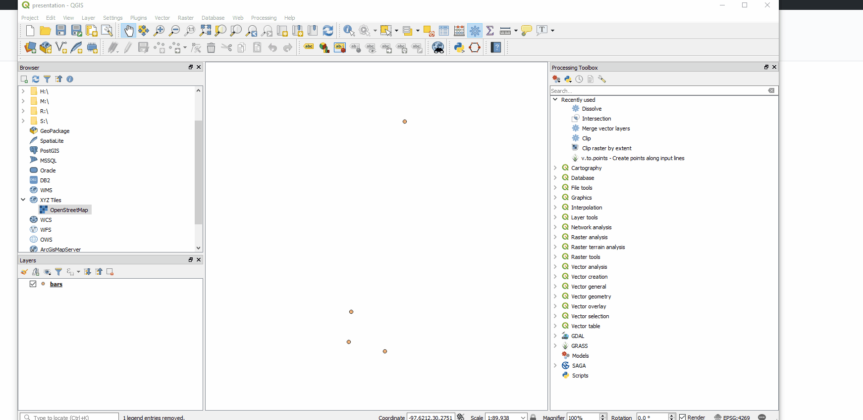
QGIS
Add a Basemap
Can be used for any common GIS task
Reading shapefiles and rasters.
Reading csv tabular data.
Making maps.
Georeferencing images.
More complex GIS tasks
Interpolation.
Projecting data.
Geoprocessing.
Ex (Calculating the area of a shapefile)
Delivering Excellence with Every Solution
7

Slide 8
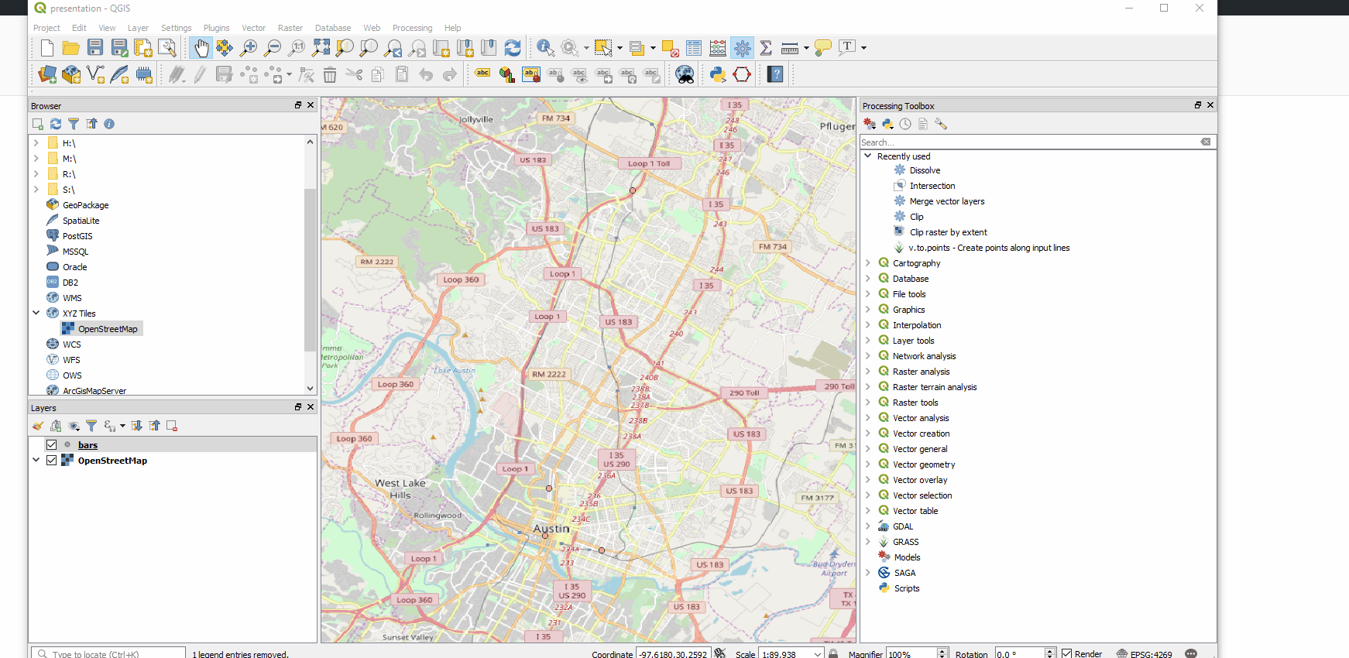
QGIS
Add Labels
Can be used for any common GIS task
Reading shapefiles and rasters.
Reading csv tabular data.
Making maps.
Georeferencing images.
More complex GIS tasks
Interpolation.
Projecting data.
Geoprocessing.
Ex (Calculating the area of a shapefile)
Delivering Excellence with Every Solution
8

Slide 9
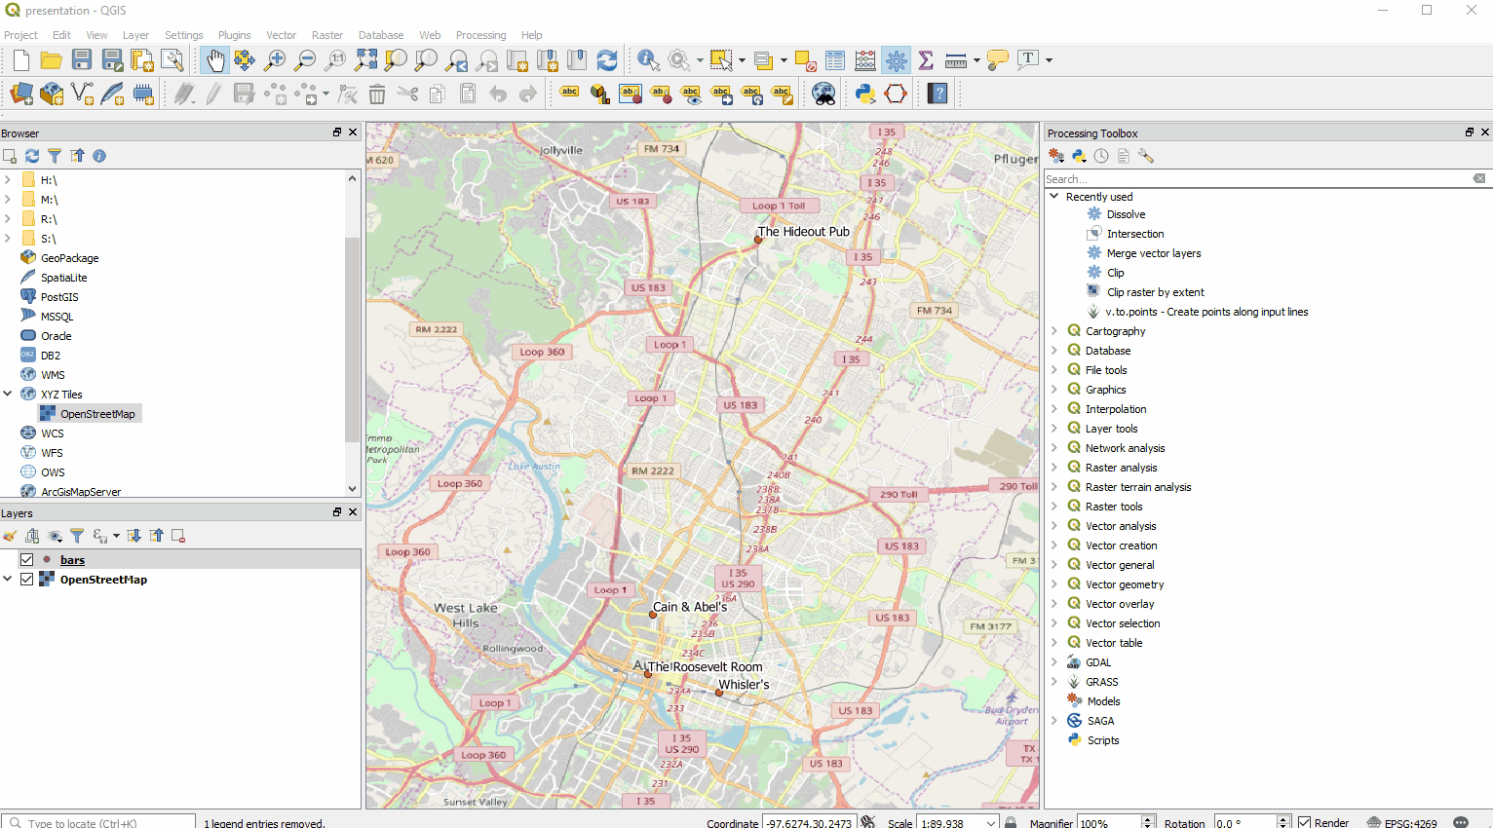
QGIS
Open the map layout tool
Can be used for any common GIS task
Reading shapefiles and rasters.
Reading csv tabular data.
Making maps.
Georeferencing images.
More complex GIS tasks
Interpolation.
Projecting data.
Geoprocessing.
Ex (Calculating the area of a shapefile)
Delivering Excellence with Every Solution
9

Slide 10
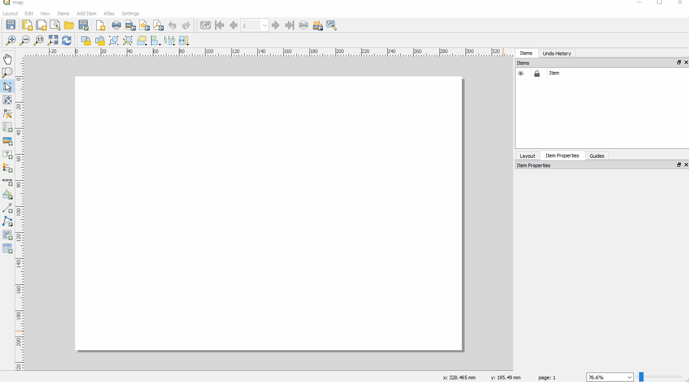
QGIS
Add Background, Scale Bar and Legend
Can be used for any common GIS task
Reading shapefiles and rasters.
Reading csv tabular data.
Making maps.
Georeferencing images.
More complex GIS tasks
Interpolation.
Projecting data.
Geoprocessing.
Ex (Calculating the area of a shapefile)
Delivering Excellence with Every Solution
10

Slide 11
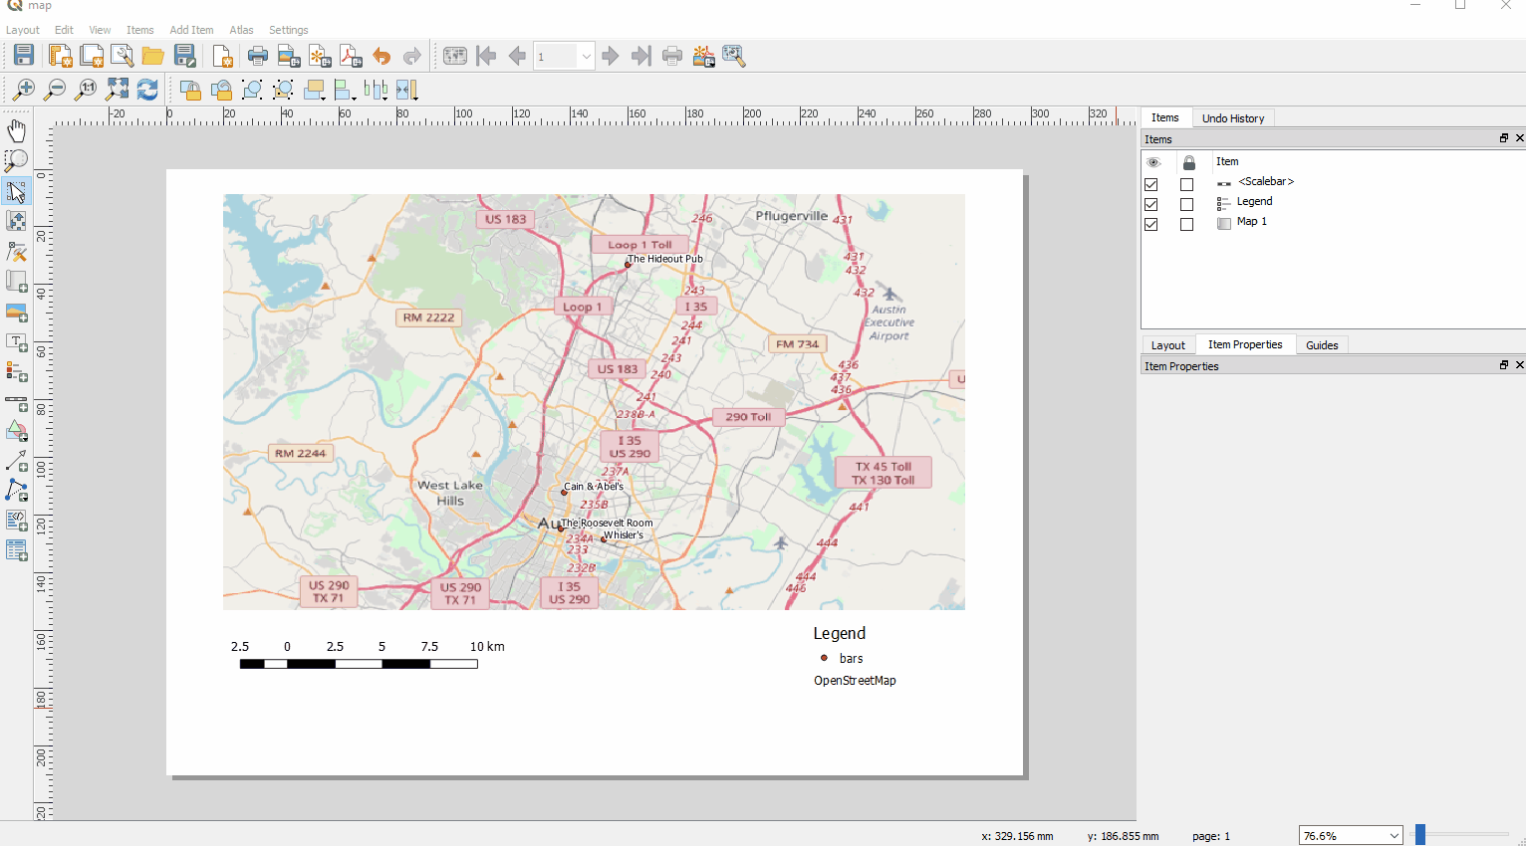
QGIS
Adjust Legend
Can be used for any common GIS task
Reading shapefiles and rasters.
Reading csv tabular data.
Making maps.
Georeferencing images.
More complex GIS tasks
Interpolation.
Projecting data.
Geoprocessing.
Ex (Calculating the area of a shapefile)
Delivering Excellence with Every Solution
11

Slide 12
QGIS
From here we can export to a pdf or png
Can be used for any common GIS task
Reading shapefiles and rasters.
Reading csv tabular data.
Making maps.
Georeferencing images.
More complex GIS tasks
Interpolation.
Projecting data.
Geoprocessing.
Ex (Calculating the area of a shapefile)
Delivering Excellence with Every Solution
12

Slide 13
QGIS
Map Layout
In the Map Layout feature you can:
Add legend(s)
Add scalebar
Add title and text
Export map to image or pdf
Delivering Excellence with Every Solution
13

Slide 14
QGIS
In closing
QGIS provides a free alternative to ArcMap
Is capable of performing many GIS tasks
Has an easy user interface
Delivering Excellence with Every Solution
14

Slide 15
QGIS
In closing
By Ross Kushnereit
rkushnereit@intera.com
512-425-2012
Delivering Excellence with Every Solution
15

